Slide 1

Engineering Mechanics
Lecture -5

Slide 2
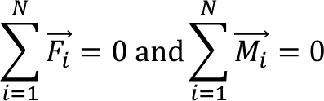
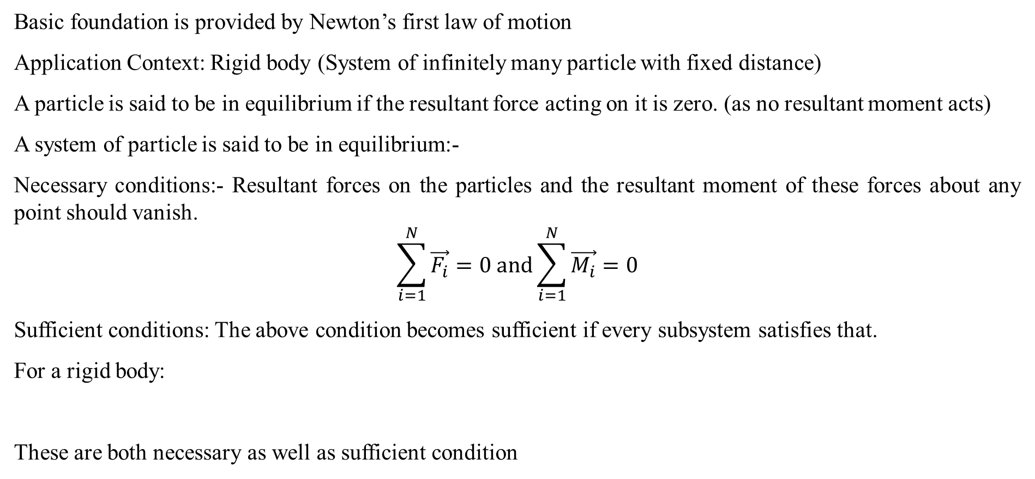
Equilibrium Equation
Basic foundation is provided by Newton’s first law of motion
Application Context: Rigid body (System of infinitely many particle with fixed distance)
A particle is said to be in equilibrium if the resultant force acting on it is zero. (as no resultant moment acts)
A system of particle is said to be in equilibrium:-
Necessary conditions:- Resultant forces on the particles and the resultant moment of these forces about any point should vanish.
$$\sum_{i=1}^{N}{\vec{F_{i}}}=0 and\sum_{i=1}^{N}{\vec{M_{i}}}=0$$
Sufficient conditions: The above condition becomes sufficient if every subsystem satisfies that.
For a rigid body:
These are both necessary as well as sufficient condition

Slide 3
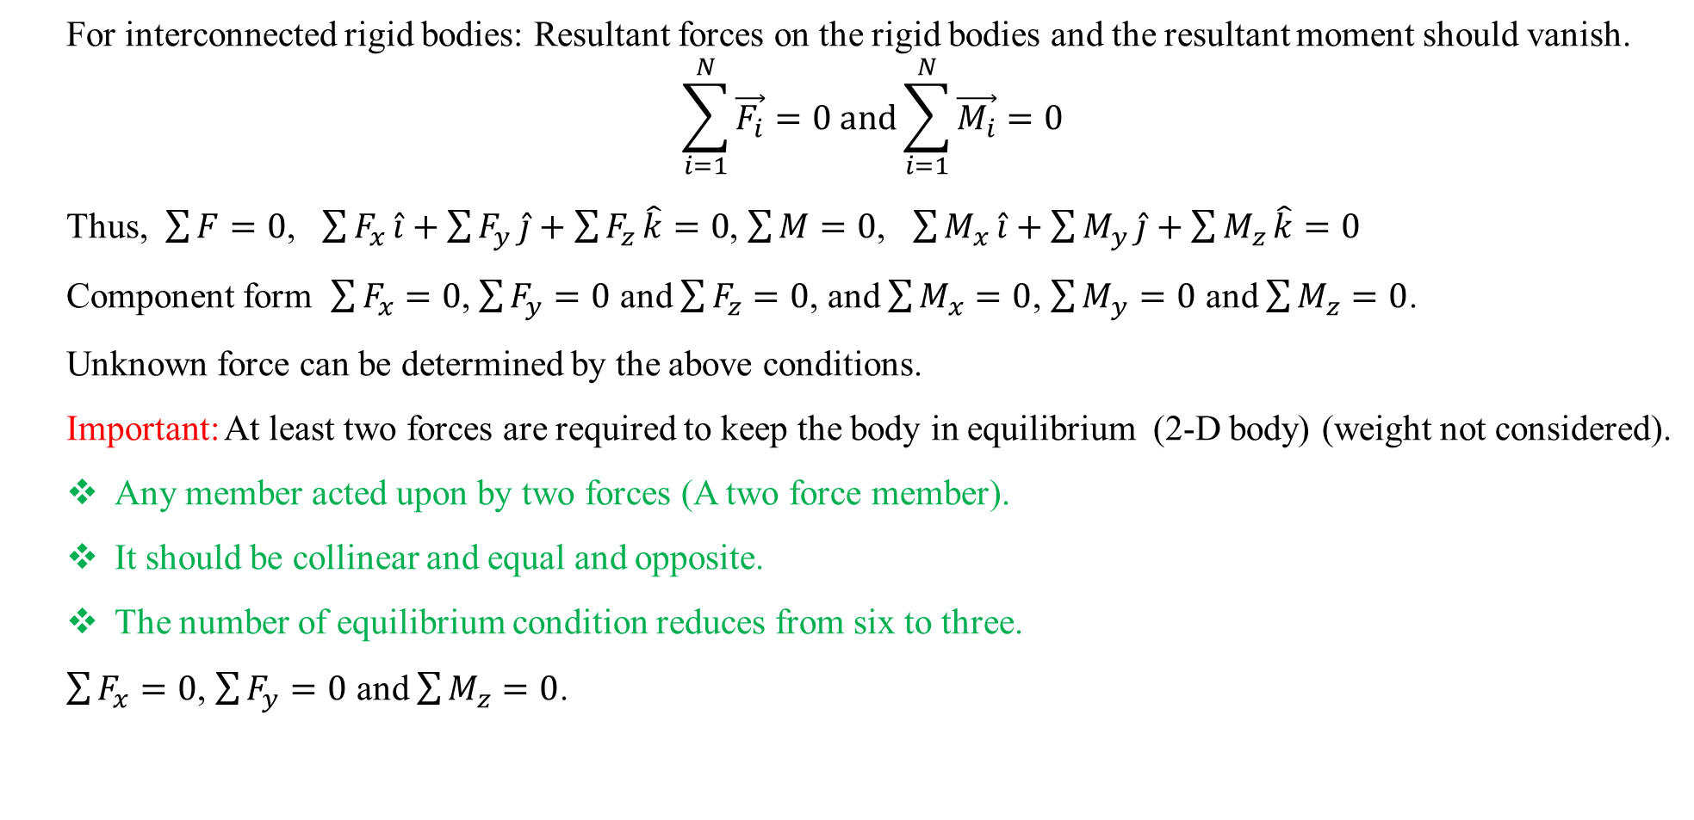
Equilibrium Equation (Interconnected rigid bodies)
For interconnected rigid bodies: Resultant forces on the rigid bodies and the resultant moment should vanish.
$$\sum_{i=1}^{N}{\vec{F_{i}}}=0 and\sum_{i=1}^{N}{\vec{M_{i}}}=0$$
Thus, $\sum{F=0}$, $\sum{F_{x}}\hat{i}+\sum{F_{y}}\hat{j}+\sum{F_{z}}\hat{k}=0$, $\sum{M=0}$, $\sum{M_{x}}\hat{i}+\sum{M_{y}}\hat{j}+\sum{M_{z}}\hat{k}=0$
Component form $\sum{F_{x}}=0$, $\sum{F_{y}}=0$ and $\sum{F_{z}}=0$, and $\sum{M_{x}}=0$, $\sum{M_{y}}=0$ and $\sum{M_{z}}=0$.
Unknown force can be determined by the above conditions.
Important: At least two forces are required to keep the body in equilibrium (2-D body) (weight not considered).
Any member acted upon by two forces (A two force member).
It should be collinear and equal and opposite.
The number of equilibrium condition reduces from six to three.
$\sum{F_{x}}=0$, $\sum{F_{y}}=0$ and $\sum{M_{z}}=0$.

Slide 4
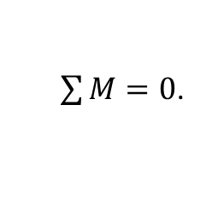
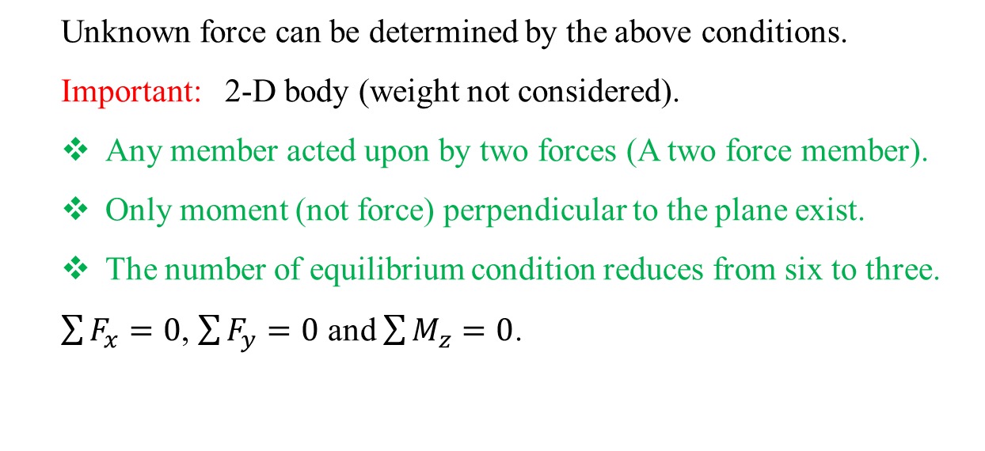
Equilibrium Equation (coplanar force system)
Unknown force can be determined by the above conditions.
Important: 2-D body (weight not considered).
Any member acted upon by two forces (A two force member).
Only moment (not force) perpendicular to the plane exist.
The number of equilibrium condition reduces from six to three.
$\sum{F_{x}}=0$, $\sum{F_{y}}=0$ and $\sum{M_{z}}=0$.
Important: Condition for zero moment for 2-D body acted by system of forces.
All forces should be concurrent.
Sum of clockwise moment and counter clockwise moment about a point should be zero.
$\sum{M}=0$.

Slide 5
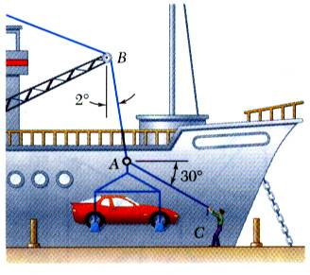
Free Body Diagram
In a ship-unloading operation, a 3500-lb automobile is supported by a cable. A rope is tied to the cable and pulled to center the automobile over its intended position. What is the tension in the rope?

Slide 6
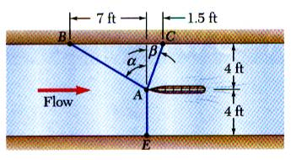
Free Body Diagram
It is desired to determine the drag force at a given speed on a prototype sailboat hull. A model is placed in a test channel and three cables are used to align its bow on the channel centerline. For a given speed, the tension is 40 lb in cable AB and 60 lb in cable AE.
Determine the drag force exerted on the hull and the tension in cable AC.

Slide 7
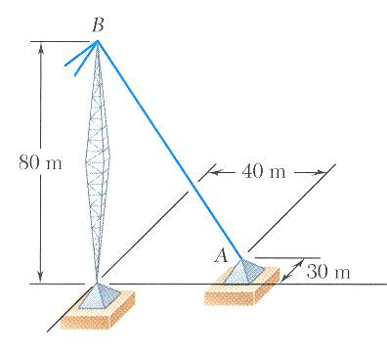
Free Body Diagram (FBD- 3D structure)
The tension in the guy wire is 2500 N. Determine:
a) components F_{x}, F_{y}, F_{z} of the force acting on the bolt at A,
b) the angles θ_{x}, θ_{y}, θ_{z} defining the direction of the force (the direction cosines)

Slide 8
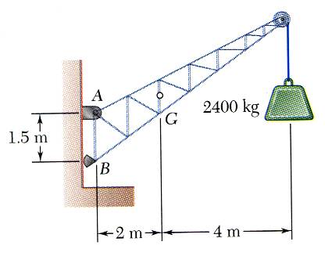
Problem
A fixed crane has a mass of 1000 kg and is used to lift a 2400 kg crate. It is held in place by a pin at A and a rocker at B. The center of gravity of the crane is located at G. Determine the components of the reactions at A and B.

Slide 9
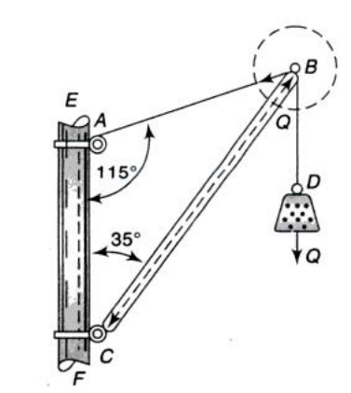
Problem
A weight Q=2225 N hanging on a cable BD is supported at point B by a cable AB and a boom BC which is hinged at C. Neglecting the weight of the cable and boom and assuming an ideal hinge at C, determine the force transmitted to the mast at point A and C.

Slide 10
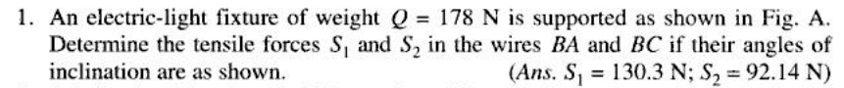
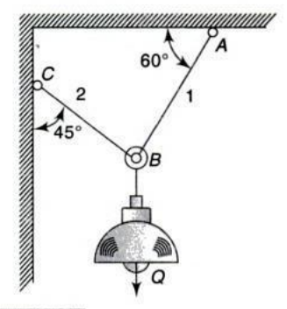
Problem

Slide 11
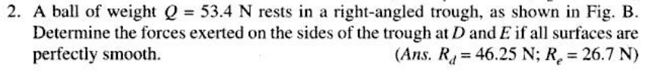
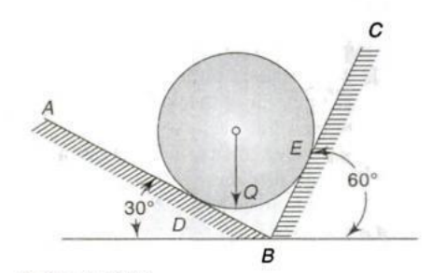
Problem

Slide 12
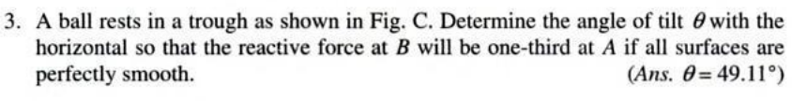
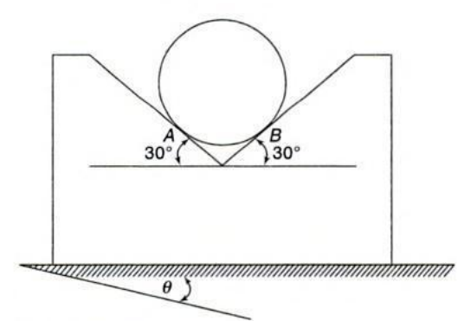
Problem

Slide 13
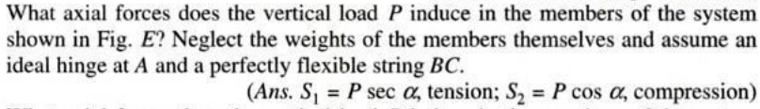
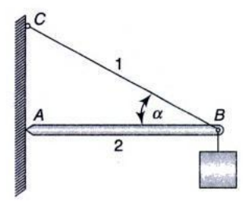
Problem

Slide 14
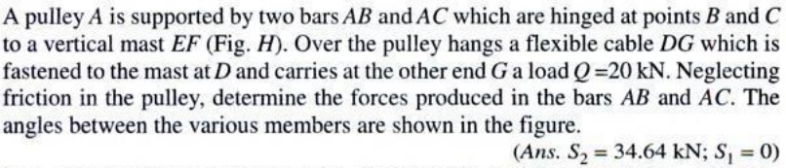
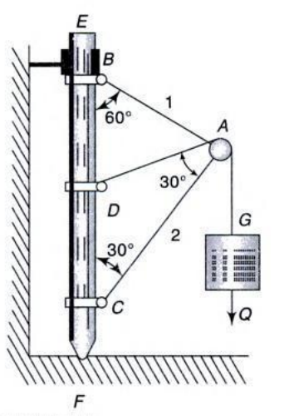
Problem

Slide 15
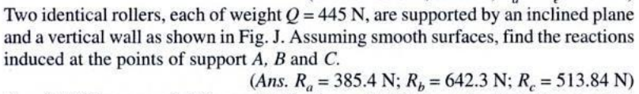
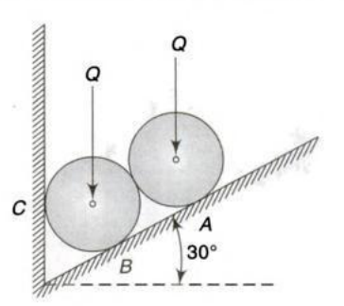
Problem

Slide 16
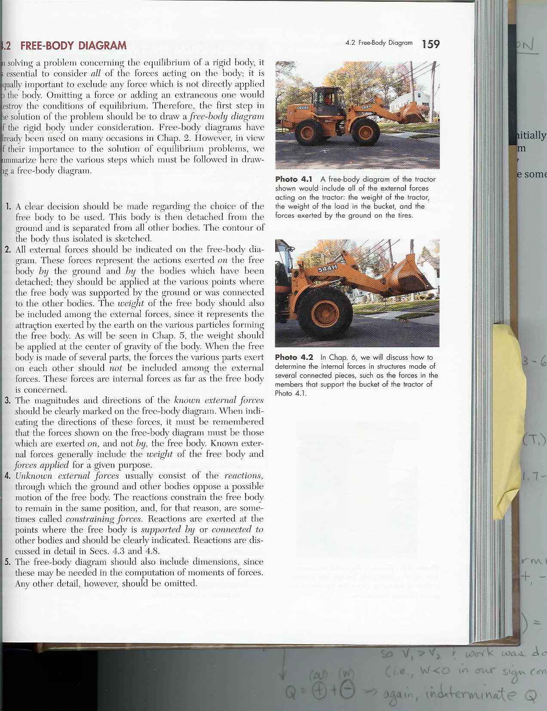
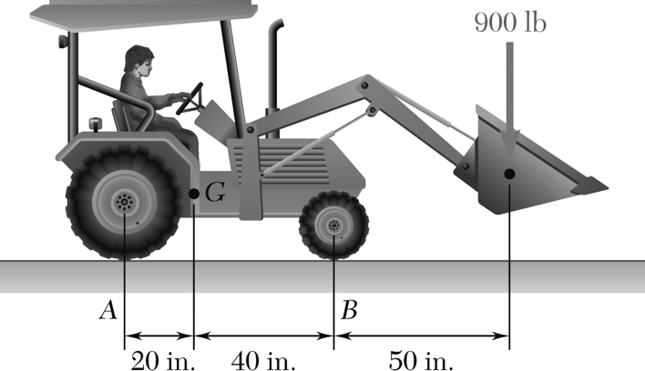
Problem
A 2100-lb tractor is used to lift 900 lb of gravel. Determine the reaction at each of the two rear wheels and two front wheels

Slide 17
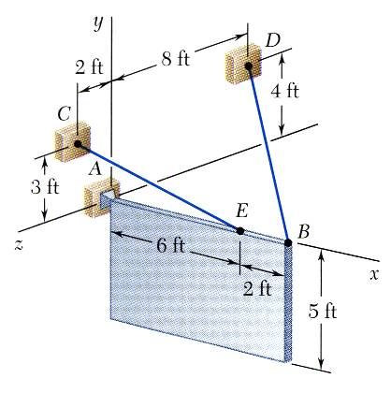
Problem
A sign of uniform density weighs 270 lb and is supported by a ball-and-socket joint at A and by two cables.
Determine the tension in each cable and the reaction at A.

Slide 18
Acknowledgement
NPTEL lectures on Engineering Mechanics
en.wikipedia.org/wiki
Beer & Johnston, Vector Mechanics for Engineers
Meriam & Kraige, Engineering Mechanics
Timoshenko & Young, Engineering Mechanics
Problems taken from internet sources

